Slide 1
First Sunday of Lent
Gospel of St Mark 1:12-15
The Spirit drove Jesus out into the wilderness and he remained there for forty days, and was tempted by Satan. He was with the wild beasts, and the angels looked after him.
After John had been arrested, Jesus went into Galilee. There he proclaimed the Good News from God. ‘The time has come’ he said ‘and the kingdom of God is close at hand. Repent, and believe the Good News.’
Extracts from Scripture from the Jerusalem Bible,
© 1966, 1967 and 1968, Darton Longman and Todd.

Slide 2
Gospel Reflection by By Marilyn Rodrigues
In this Gospel passage, we are led quickly from Jesus’ time in the wilderness to His appearance in Galilee where He announces His Good News to the world. It might therefore be easy for us to gloss over His being tempted by Satan, and assume that it didn’t cause Him to suffer since, as God, He did not sin.
But if we do that, we miss the full force of His Good News! Jesus, the only Son of His Father and truly God, is also truly one of us. He really was open to the full range of human experience in all things, but sin. This experience includes both vulnerability and human weaknesses; if this were not the case, He could not have suffered temptation, and later, His Passion. This is good news because it reveals that our own weaknesses—those imperfections that make us worry and fret—need not be an obstacle to holiness. In suffering human frailty Himself, Jesus transforms our weaknesses into our path to salvation.
Sometimes our temptations and weaknesses, especially those that bother us the most about ourselves, make us want to scurry off the path in shame; once glimpsed, we often would rather avoid facing them. Yet, all we need to do is decide, once and for all, to walk along the path of holiness with Jesus, and not to be discouraged at how many times we trip over our feet and fall flat on our faces! Jesus invites us to walk humbly and to acknowledge our imperfections. When we do this, we will find it easier to accept our neighbours with all of their faults and flaws, and thereby, reveal God’s love to them. Our reward will be a heart that increases with gratitude and love for Jesus, who stays with us regardless of how many times we fall.
This Lent, let us allow Jesus to meet us in our weakness, and show us the ways in which we need to change. Let Him!

Slide 3
Questions
Which word or phrase of the Gospel or the reflection spoke to me, and what might God be saying to me?
Which areas of weakness and temptation in my life does Jesus want me to acknowledge and bring to Him?
Is there someone whom I struggle to love because of his or her weakness? How can I love that per son, and witness to the love and mercy of God?

Slide 4
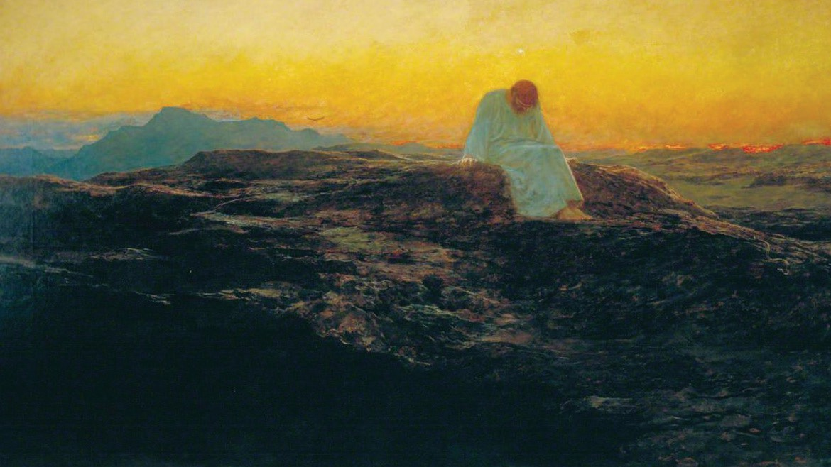
The Temptation in the Wilderness by Briton Riviere, circa 1898. Credit: City of London Corporation, CC BY-NC

Slide 5
Second Sunday of Lent
Gospel of St Mark 9:2-10
Jesus took with him Peter and James and John and led them up a high mountain where they could be alone by themselves. There in their presence he was transfigured: his clothes became dazzlingly white, whiter than any earthly bleacher could make them. Elijah appeared to them with Moses; and they were talking with Jesus. Then Peter spoke to Jesus: ‘Rabbi,’ he said ‘it is wonderful for us to be here; so let us make three tents, one for you, one for Moses and one for Elijah.’ He did not know what to say; they were so frightened. And a cloud came, covering them in shadow; and there came a voice from the cloud, ‘This is my Son, the Beloved. Listen to him.’ Then suddenly, when they looked round, they saw no one with them any more but only Jesus.
As they came down from the mountain he warned them to tell no one what they had seen, until after the Son of Man had risen from the dead. They observed the warning faithfully, though among themselves they discussed what ‘rising from the dead’ could mean.
Extracts from Scripture from the Jerusalem Bible,
© 1966, 1967 and 1968, Darton Longman and Todd.

Slide 6
Gospel Reflection by Mark Lysaght
As we contemplate the Transfiguration during Lent, may we be inspired to ascend our own mountains of prayer, embrace transformation, and carry the light of Christ into the world, becoming beacons of hope and love in a world in need of redemption. In the heart of the Lenten Season, the Gospel reading from Mark beckons us to heed the profound call to repent and believe, so that we may be filled with the love of God. The Transfiguration of Jesus on the mountain unfolds as a Divine Revelation, a manifestation of God’s overwhelming love that pierces through the darkness of sin.
As we journey through Lent, the theme of repentance resonates with urgency. The dazzling radiance of Jesus on the mountain signals the transformative power of repentance, a turning away from the shadows that cloak our hearts. Lent invites us to confront the darkness within, acknowledging our need for God’s mercy and forgiveness. “Repent and believe” echoes as a timeless invitation, a call to turn our gaze toward the Light of the World. The Transfiguration scene reveals Jesus in His divine glory, a tangible expression
of the love that surpasses all understanding. Lent is not merely a season of self-denial but a profound opportunity to surrender to the embrace of God’s love, to believe in the transformative power of His grace. The urgency in the Lenten readings is palpable. The disciples, much like us, are urged to listen to the voice from the cloud: “This is my beloved Son; listen to him.” In the tumult of our lives, the voice of Jesus resonates with unwavering love, inviting us to trust, to believe, and to be filled with the love of God.
The promise of eternal life with God underlines the significance of our Lenten journey. In turning away from sin and embracing the love of God, we align ourselves with the Kingdom that Jesus ushers in. The Transfiguration is a foretaste of the glory that awaits those who repent and believe—a glimpse of the eternal joy that our hearts long for. As we reflect on the Gospel reading of Mark this Lent, let us respond to the urgent call to repentance and belief. May the love of God, revealed in the Transfiguration, illuminate our path, dispel the darkness within, and propel us toward the embrace of eternal life with Him.

Slide 7
Questions
Which word or phrase of the Gospel or the reflection spoke to me, and what might God be saying to me?
Do I truly repent of my sins? Am I willing to go to the Confession this Lent, and be transformed by the power of His grace?
What is one concrete way that I can be a beacon of hope and love in a world in need of redemption?

Slide 8
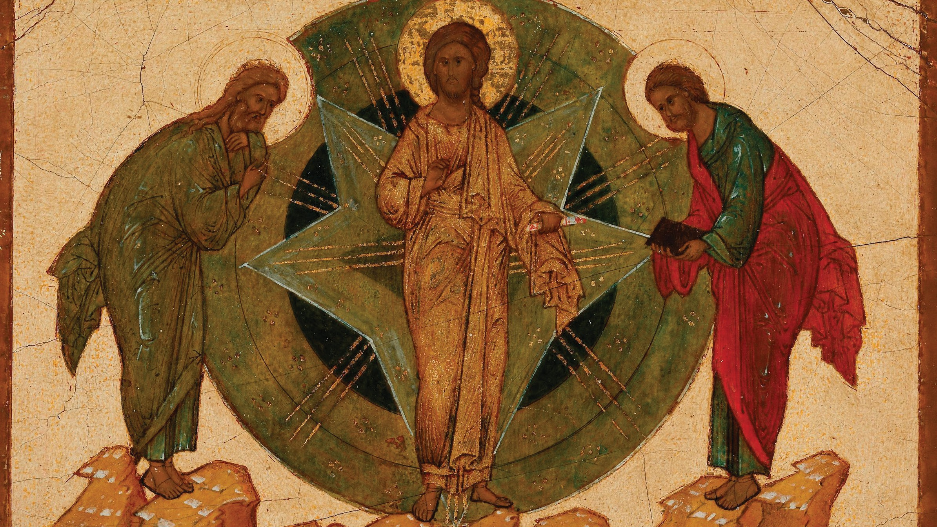
The Transfiguration of Christ by Uidentifisert, Novgorod- skolenby, c. mid-16th century. Credit: The National Museum in Oslo / CC BY 4.0

Slide 9
Third Sunday of Lent
Gospel of St John 2:13-25
Just before the Jewish Passover Jesus went up to Jerusalem, and in the Temple he found people selling cattle and sheep and pigeons, and the money-changers sitting at their counters there. Making a whip out of some cord, he drove them all out of the Temple, cattle and sheep as well, scattered the money-changers’ coins, knocked their tables over and said to the pigeon-sellers, ‘Take all this out of here and stop turning my Father’s house into a market.’ Then his disciples remembered the words of scripture: Zeal for your house will devour me. The Jews intervened and said, ‘What sign can you show us to justify what you have done?’ Jesus answered, ‘Destroy this sanctuary, and in three days I will raise it up.’ The Jews replied, ‘It has taken forty-six years to build this sanctuary: are you going to raise it up in three days?’ But he was speaking of the sanctuary that was his body, and when Jesus rose from the dead, his disciples remembered that he had said this, and they believed the scripture and the words he had said.
During his stay in Jerusalem for the Passover many believed in his name when they saw the signs that he gave, but Jesus knew them all and did not trust himself to them; he never needed evidence about any man; he could tell what a man had in him.
Extracts from Scripture from the Jerusalem Bible,
© 1966, 1967 and 1968, Darton Longman and Todd.

Slide 10
Gospel Reflection by Sister Maliya Suen, RSM
In this Gospel passage, we read about Jesus, who zealously overturned tables and drove the market people out of the Temple with a cord. This encounter was not designed to promote civil unrest or violence, but rather to teach us to order our zeal towards God. The zeal of Jesus is a consuming fire of love for God the Father which ultimately led Him to the Cross; Jesus’ statement at the end of the confrontation, “in three days I will raise it up”, referred to His self-sacrifice on the Cross and His resurrection. How eager are we to cleanse the temple of our souls and to welcome the Holy Trinity to dwell within us?
Imagine that a child wonders off on a family walk. At first the parents gently ask the child to come back. But now the child keeps moving away and is near the edge of a road with heavy traffic, and the parents quickly move the
child away from danger. Such action may appear sudden, decisive and even stern from the child’s perspective, especially if he or she did not realise the imminent danger of the situation. Yet the parents acted out of love and for the sake of the child’s life. Likewise, there are times in our lives when we need the zeal of Jesus to wake us up, to turn us back to God and towards the path of holiness. Do we use these moments of being shaken up to seek the Truth? This Lenten Season, when wereceive an experience of Jesus overturning our tables in order to catch our attention, let us take courage and allow the love of Jesus to consume us. May He enter our hearts and cleanse us, He who already knows where the stain is and how to make our temple clean again!

Slide 11
Questions
Which word or phrase of the Gospel or the reflection spoke to me, and what might God be saying to me?
Am I willing to allow Jesus to cleanse the temple of my soul?
In which way can I help those I love to see the need for Jesus to wake them up, and to turn back to God?

Slide 12
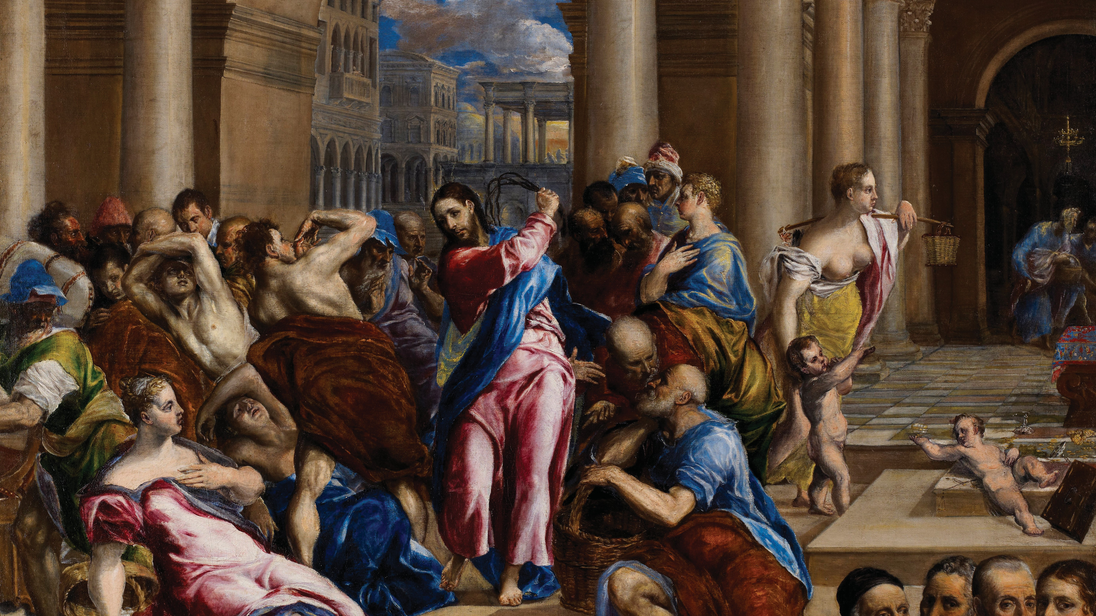
Christ Driving the Money Changers from the Temple by El Greco, c. 1570-75. Credit: Minneapolis Institute of Art / Public Domain

Slide 13
Fourth Sunday of Lent
Gospel of St John 3:14-21
Jesus said to Nicodemus:
‘The Son of Man must be lifted up as Moses lifted up the serpent in the desert, so that everyone who believes may have eternal life in him. Yes, God loved the world so much that he gave his only Son, so that everyone who believes in him may not be lost but may have eternal life. For God sent his Son into the world not to condemn the world, but so that through him the world might be saved. No one who believes in him will be condemned; but whoever refuses to believe is condemned already, because he has refused to believe in the name of God’s only Son. On these grounds is sentence pronounced: that though the light has come into the world men have shown they prefer darkness to the light
because their deeds were evil. And indeed, everybody who does wrong hates the light and avoids it, for fear his actions should be exposed; but the man who lives by the truth comes out into the light, so that it may be plainly seen that what he does is done in God.’
Extracts from Scripture from the Jerusalem Bible,
© 1966, 1967 and 1968, Darton Longman and Todd.

Slide 14
Gospel Reflection by Dr Kevin Wagner
In Dostoyevsky’s Crime and Punishment, the central characterRaskolnikovliterallygetsawaywithmurdering an elderly woman and her half–sister. As the novel unfolds, we get a penetrating glimpse into the mind of a sinner as Dostoyevsky recounts Raskolnikov’s thoughts; as he plays the scene out in his head, connives to avoid capture, and tries to justify to himself his abhorrent actions.
Perhaps the reason the novel has received acclaim throughout the years is that the honest reader sees him or herself in the character of Raskolnikov. We know deep down that we have sinned, in our thoughts, in our words, in what we have done, and in what we have failed to do.
Jesus came to draw us out of the darkness of sin and into His light. Jesus truly experienced temptation. To
deny this would be to deny His humanity! What this means is that Jesus understands me and the temptations I wrestle with. He knows my heart—He created it!— and despite the filth He sees in me, He loves me.
Fear of being caught out in our sin can cripple us. The Christian, however, ought not fear! This week we hear that God sent Jesus to save the world, not to condemn it. On the other hand, in John 5:22–24 we read that all judgement is given to the Son. What can we make of this? The key is hearing and believing in His Word. Jesus, the just Judge, invites us to hear His Word and to believe in God. Our belief is all He asks for. May this Lent be a time where we can each live this call more fully and encourage others to do the same. The reward for doing so is life eternal!

Slide 15
Questions
Which word or phrase of the Gospel or the reflection spoke to me, and what might God be saying to me?
In which moments of my life has Jesus drawn me out of the darkness of sin, and into His light?
Whom will I encourage this week to trust and believe in the love of God?

Slide 16
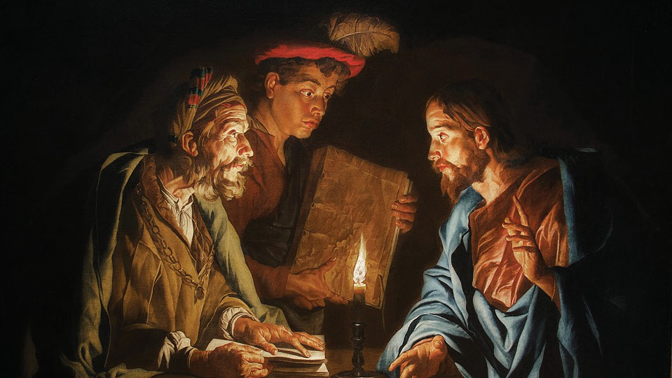
Jesus Christ and Nicodemus by Matthias Stom, circa between 1640 and 1650.
Credit: picryl.com / Public Domain

Slide 17
Fifth Sunday of Lent
Gospel of St John 12:20-33
Among those who went up to worship at the festival were some Greeks. These approached Philip, who came from Bethsaida in Galilee, and put this request to him, ‘Sir, we should like to see Jesus.’ Philip went to tell Andrew, and Andrew and Philip together went to tell Jesus. Jesus replied to them:
‘Now the hour has come for the Son of Man to be glorified. I tell you, most solemnly, unless a wheat grain falls on the ground and dies, it remains only a single grain; but if it dies, it yields a rich harvest. Anyone who loves his life loses it; anyone who hates his life in this world will keep it for the eternal life. If a man serves me, he must follow me, wherever I am, my servant will be there too. If anyone serves me, my Father will honour him. Now my soul is troubled. What shall I say: Father, save me from this hour? But it was for this very reason that I have come to this hour. Father, glorify your name!’
Extracts from Scripture from the Jerusalem Bible,
© 1966, 1967 and 1968, Darton Longman and Todd.

Slide 18
Fifth Sunday of Lent
Gospel of St John 12:20-33
A voice came from heaven, ‘I have glorified it, and I will glorify it again.’ People standing by, who heard this, said it was a clap of thunder; others said, ‘It was an angel speaking to him.’ Jesus answered, ‘It was not for my sake that this voice came, but for yours.
‘Now sentence is being passed on this world; now the prince of this world is to be overthrown. And when I am lifted up from the earth, I shall draw all men to myself.’
By these words he indicated the kind of death he would die.
Extracts from Scripture from the Jerusalem Bible,
© 1966, 1967 and 1968, Darton Longman and Todd.

Slide 19
Gospel Reflection by Hazel Lim
In both obvious and in more subtle ways, our current sociocultural environment prescribes ‘putting yourself first’ as a supposed path to happiness and attaining the best life. Our Gospel reading challenges this notion and presents a starkly different, less comforting approach – we are invited by Jesus to ‘die to ourselves’ in order to enter into the fullness of life.
Like the visitors at the Passover Festival, we yearn to ‘see Jesus’ and experience His grace, mercy, and love. In His response to Phillip and Andrew, Jesus proclaims “unless a wheat grain falls on the ground and dies, it remains only a single grain; but if it dies, it yields a rich harvest” (John 12:24). In foreshadowing His own sacrifice upon the Cross, Jesus also teaches and invites the disciples to empty themselves in love, dying to sin in order to make room for God’s grace to work in us and penetrate our hearts, and by this way transform the world. It is in embracing this Paschal Way that we can truly, completely, and intimately ‘see’ Jesus.
Our dying makes space for new life to arise. Immersed and renewed in God’s overflowing love, we return to our true identities as God’s children, and experience the abundance of life that only a radical surrender to God makes possible. We see with new eyes, and love with a new heart. Like the Blessed Mother and the great saints, we empty ourselves to be filled by grace, becoming children of light—Christ’s light—in the world (John 12:36).
The promise of new life is proven in Jesus’ death and resurrection. He is the single grain that has become the Bread of Life. As we relive the Sacrifice of the Cross, the finding of an empty tomb, and the dawn of a new day this Holy Week, may we be assured in faith that the demands of self-giving love are the path to life in its fullness, to life everlasting.

Slide 20
Questions
Which word or phrase of the Gospel or the reflection spoke to me, and what might God be saying to me?
Do I really yearn to see Jesus? How can I make small acts of self-giving love this week so that I experience His grace, love and mercy?
How can I encourage another person to make a radical surrender to God?

Slide 21
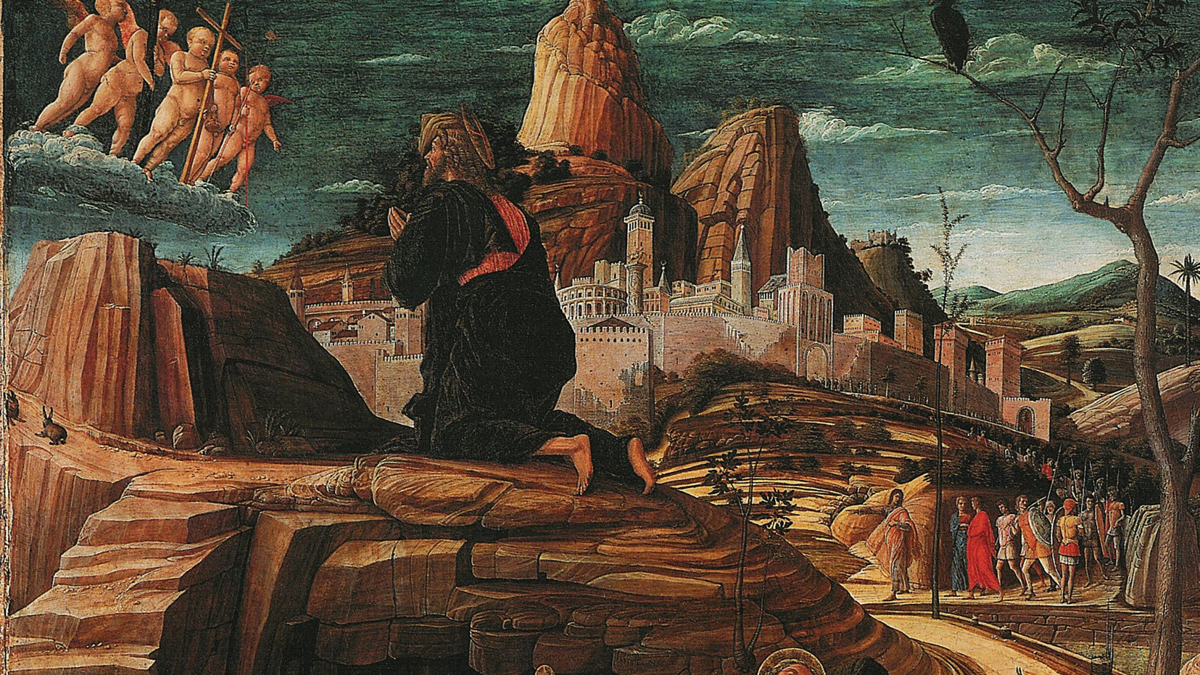
The Agony in the Garden by Andrea Mantegna, c. circa from 1455 until 1456.
Credit: Art Gallery ErgsArt / Flickr, Public Domain

Slide 22
Palm Sunday
Gospel of St Mark 15:16-39*
The soldiers led him away to the inner part of the palace, that is, the Praetorium, and called the whole cohort together. They dressed him up in purple, twisted some thorns into a crown and put it on him. And they began saluting him, ‘Hail, king of the Jews!’ They struck his head with a reed and spat on him; and they went down on their knees to do him homage. And when they had finished making fun of him, they took off the purple and dressed him in his own clothes. They led him out to crucify him. They enlisted a passer-by, Simon of Cyrene, father of Alexander and Rufus, who was coming in from the country, to carry his cross. They brought Jesus to the place called Golgotha, which means the place of the skull. They offered him wine mixed with myrrh, but he refused it. Then they crucified him, and shared out his clothing, casting lots to decide what each should get. It was the third hour when they crucified him. The inscription giving the charge against him read: ‘The King of the Jews.’ And they crucified two robbers with him, one on his right and one on his left. The passers-by jeered at him; they shook their heads and said, ‘Aha! So you would destroy the Temple and rebuild it in three days!
Extracts from Scripture from the Jerusalem Bible,
© 1966, 1967 and 1968, Darton Longman and Todd.

Slide 23
Palm Sunday
Gospel of St Mark 15:16-39*
Then save yourself: come down from the cross!’ The chief priests and the scribes mocked him among themselves in the same way. ‘He saved others,’ they said ‘he cannot save himself. Let the Christ, the king of Israel, come down from the cross now, for us to see it and believe.’ Even those who were crucified with him taunted him. When the sixth hour came there was darkness over the whole land until the ninth hour. And at the ninth hour Jesus cried out in a loud voice, ‘Eloi, Eloi, lama sabachthani?’ which means, ‘My God, my God, why have you deserted me?’ When some of those who stood by heard this, they said, ‘Listen, he is calling on Elijah.’ Someone ran and soaked a sponge in vinegar and, putting it on a reed, gave it him to drink, saying, ‘Wait and see if Elijah will come to take him down’. But Jesus gave a loud cry and breathed his last. And the veil of the Temple was torn in two from top to bottom. The centurion, who was standing in front of him, had seen how he had died, and he said, ‘In truth this man was a son of God’.
* Excerpt from Mark 15:1-39
Extracts from Scripture from the Jerusalem Bible,
© 1966, 1967 and 1968, Darton Longman and Todd.

Slide 24
Gospel Reflection by Fr Sam Lynch
Compassion means to ‘suffer with.’ During Lent, the Church calls upon us to have compassion on Jesus Christ by contemplating His suffering and death. This active reception of the Word of God brings healing for us since “by his wounds we are healed” (Isaiah 53:5). This is a great mystery: a reality that we cannot ever fully grasp, but can only enter into more and more deeply. By contemplating the Word of God, we encounter Him. In encountering Him, we receive His grace, and are transformed.
At the start of Holy Week, as we join the procession of people acclaiming Jesus as the King of Israel, the Church immediately directs our eyes towards His suffering and death, for His is not an earthly Kingdom (cf John 18:36). St Mark relates to us that Jesus gave up His spirit upon saying the words “My God, My God, why have you deserted me?” These words are
the opening line of Psalm 22, in which is related what has just been seen: the Lord’s garments are divided among the soldiers, they throw dice for His robe; His hands and feet are pierced as they nail Him to the cross; He is mocked and derided by all who pass by.
Despite its first line, and its grim prophecy, Psalm 22 does not end in despair. Rather, it is an expression of hope and trust in the God of Israel and His salvation. St Mark relates how witnessing the saving death of Jesus Christ affected the Centurian, the leader of the Roman soldiers who were putting Him to death; seeing how Jesus had died, he said: “Truly, this man was a Son of God.” Standing beside the Cross of Christ, as we enter compassionately into the scene, our faith is also renewed.

Slide 25
Questions
Which word or phrase of the Gospel or the reflection spoke to me, and what might God be saying to me?
In which way can I be renewed in my faith this week, and stand beside the Cross of Christ?
How can I help others to enter into the scene of Jesus’ Passion and Death this week?

Slide 26
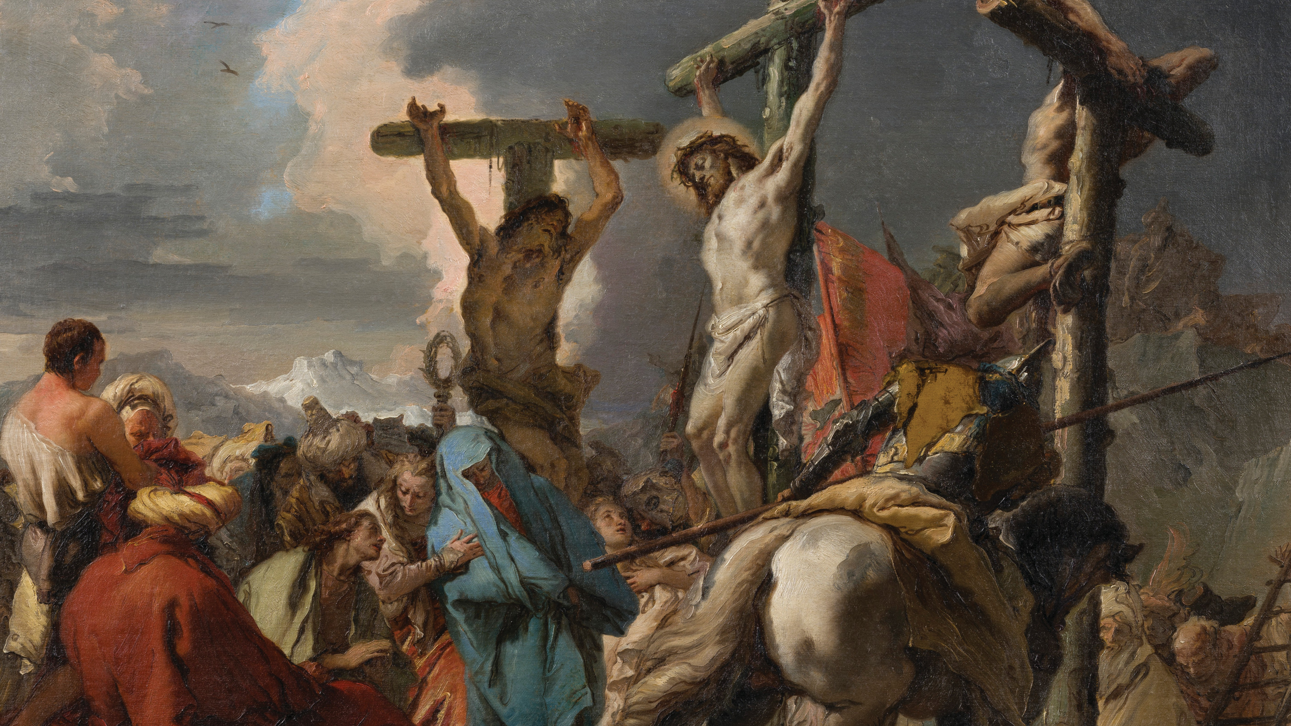
The Crucifixion by Giambattista Tiepolo, c. 1745–50. Credit: Saint Louis Art Museum / Public Domain

Slide 27
Easter Sunday
Gospel of St Mark 16:1-8
When the sabbath was over, Mary of Magdala, Mary the mother of James, and Salome, bought spices with which to go and anoint him. And very early in the morning on the first day of the week they went to the tomb, just as the sun was rising. They had been saying to one another, ‘Who will roll away the stone for us from the entrance to the tomb?’ But when they looked they could see that the stone – which was very big
– had already been rolled back. On entering the tomb they saw a young man in a white robe seated on the right-hand side, and they were struck with amazement. But he said to them, ‘There is no need for alarm. You are looking for Jesus of Nazareth, who was crucified: he has risen, he is not here. See, here is the place where they laid him. But you must go and tell his disciples and Peter, “He is going before you to Galilee; it is there you will see him, just as he told you.”’
Extracts from Scripture from the Jerusalem Bible,
© 1966, 1967 and 1968, Darton Longman and Todd.

Slide 28
Gospel Reflection by Fr Richard Sofatzis
Three women with hearts deeply moved by a sorrowful love for their Lord, Jesus, rise very early to anoint His dead body— without even giving a thought to the difficulties of rolling back the stone. One of the women, Mary Magdalene, had already been filled with Jesus’ forgiving and merciful love when He saved her from the affliction of as many as seven demons. Mary was drawn to Jesus through an outpouring of His love, and with her heart burning with this gift, she accompanied Jesus to His last agony as He hung dying on the Cross. And yet now, in Mary’s eyes, it looks like all hope is lost: Jesus is dead.
In this moment of confusion, Christ strikes Mary’s heart once more, this time with amazement: “You are looking for Jesus of Nazareth, who was crucified: he has risen, he is not here.” By His death on the Cross, Jesus transformed an act of destruction into an act of love—a prayer to the Father for
all mankind. And now, by His resurrection, Jesus reveals this love and proclaims definitively: the love of God is mightier than death!
At the Easter Vigil, as the priest lights the Paschal Candle from the fire he proclaims: “May the light of Christ rising in glory dispel the darkness of our hearts and minds.” The resurrection of Christ shocks us with the reality that our human vision for life, for meaning, for purpose, is too limited—God’s ways are beyond our wildest expectations!
The Virgin Mary stood with these three other women at the Cross but is now noticeably absent. For only she preserved the light amidst the great darkness, holding fast to the promises of her Son. Imploring her help, may we believe and, filled with love mightier than death, bear the light of Christ to the world!

Slide 29
Questions
Which word or phrase of the Gospel or the reflection spoke to me, and what might God be saying to me?
When is a moment in my life when I have experienced that God’s ways are beyond my wildest expectations?
How will I reveal the joy of the Risen Christ this Easter to those who are in need of His light?

Slide 30
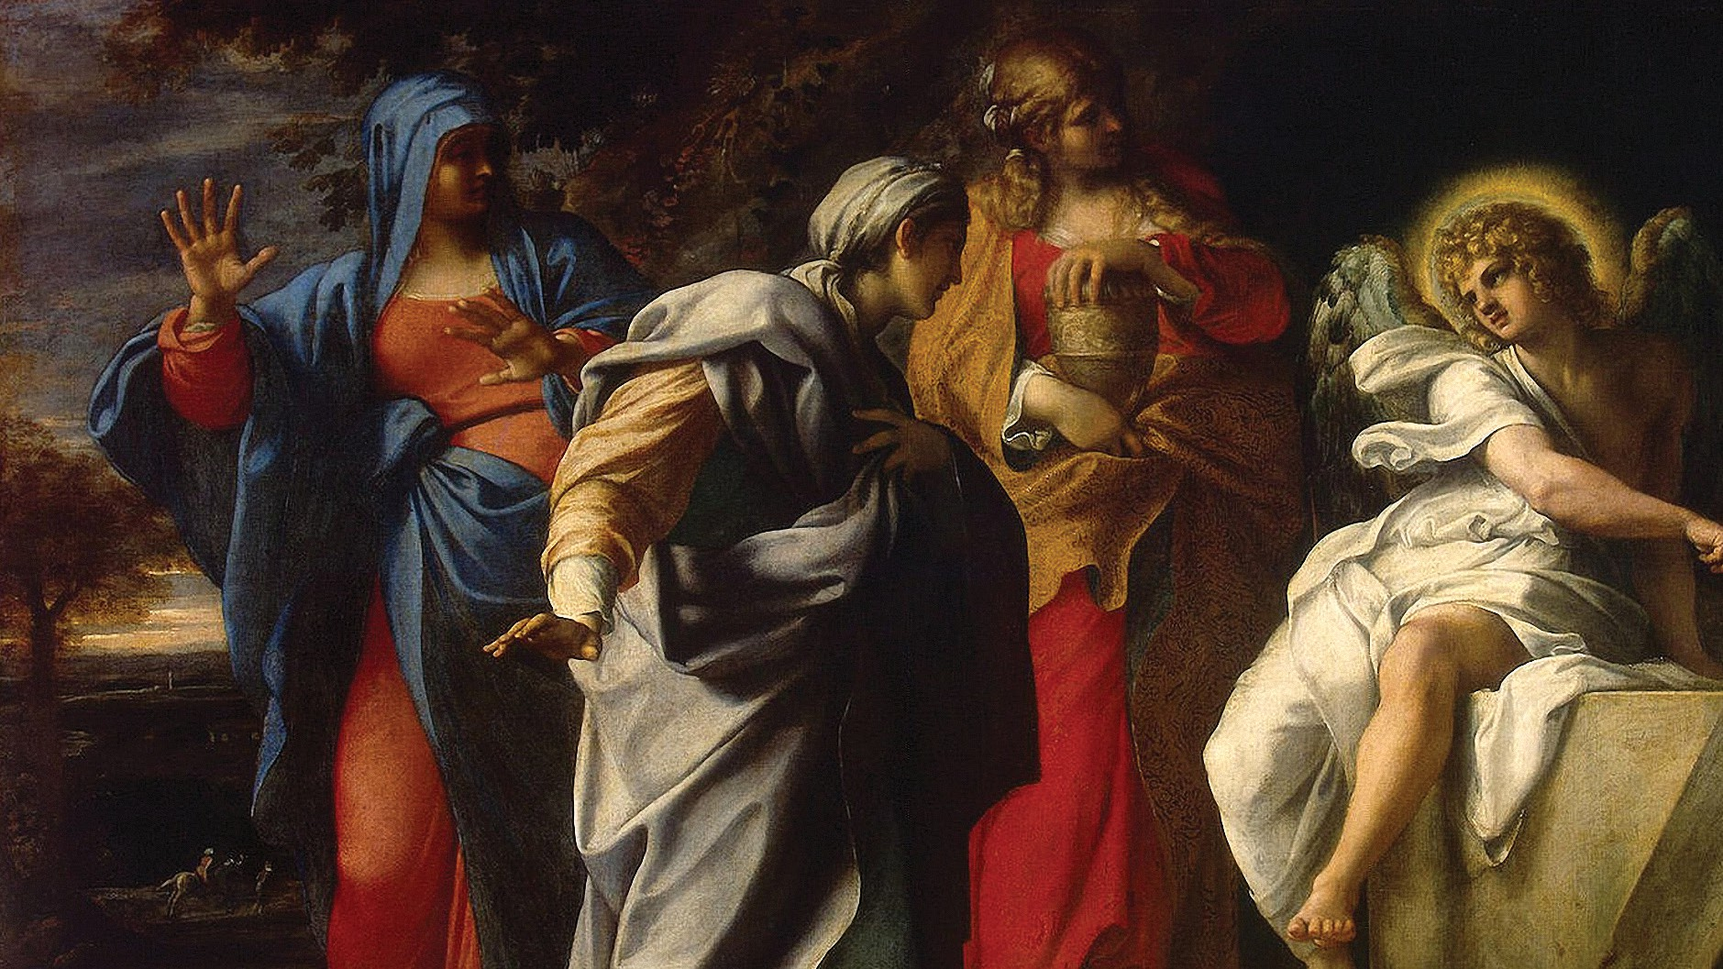
The Holy Women at Christ’s Tomb by Annibale Carracci, c. late 16th century. Credit: Lluís Ribes Mateu / Flickr, CC BY-NC 2.0 DEED

